Slide 1

Sesame – GenX comparison, Vol. II
Ruaridh Macdonald, Amanda Farnsworth
Version: 15th August, 2023

Slide 2
Comparison Overview
We built a simplified model of ISO-NE which could be modelled by both Sesame and GenX, given the features and resources which can be modelled in both.
Both models were fully linearized, removing ramping constraints, minimum powers, etc.
Sesame and GenX were compared based on:
The total system cost: investment costs, fixed O&M, variable O&M, and fuel costs
Installed capacity of each generator
Capacity factor of each generator
Last week:
We found Sesame and GenX gave very different answers, which could not be explained by solver tolerances
Both systems gave very different total system costs, even when forced to install the same number of FPPs
This week:
We found that Sesame and GenX were processing the input costs differently, resulting in different annualized costs
Once this was resolved, both models produce the exact same results when using the same fusion power plant model
The full fusion model in GenX leads to different results

Slide 3

Model Details
Descriptions of annual electricity demand in the model (MWe)
Demand metric (MWe) | Mean | Median | Max | Min
ISO-NE | 21719 | 21867 | 42825 | 9912
QC
Generation and storage resources allowed in each zone
Resource | Annualized Capital Cost ($/kWe) | Fixed OM Cost ($/MWe/yr) | Variable OM Cost ($/MWh-e) | Fuel Cost ($/MWh-e)
Natural Gas CombCycle | 33,300 | 28,000 | 2 | 44.6
Nat Gas CombCycle + CCS | 62,800 | 60,000 | 6 | 56.2
Utility-scale Solar PV | 27,700 | 13,000
Onshore Wind | 38,900 | 38,900
4hr Li-ion | 52,100 | 17,000
Fixed Offshore Wind | 129,900 | 71,000
Fusion | 521,200 | 146,000 | 3.0 | 0
ISO-NE
Maximum allowed installed capacity for certain resources, across all ISO-NE
Resource | Utility-scale Solar PV | Onshore Wind
Maximum installed capacity (GWe) | 22 | 10

Slide 4
Model Details
Sesame and GenX have different representations of fusion power plants
Sesame model and GenX-Simple
Fusion reactor treated as a typical thermal generator
$ 8,500/kWe total capital cost
All vacuum vessel costs are treated as upfront capital costs
Not clear if this is one or all required vacuum vessels
GenX-Variable Cost
Vacuum vessel moved to variable costs
This ensures all required vacuum vessels are included
GenX – Full model
Vacuum vessel replacement modelled explicitly
Fuel modelled explicitly

Slide 5
Results: Summary
Sesame and GenX return the same results (within solver tolerances) when both use the same model of fusion power plants
However, using the other models of fusion power plants leads to differences
How are the second and later vacuum vessels accounted for in the simple model?
Total system cost comparison
 | Sesame | GenX Simple Fusion | GenX Variable VV | GenX Full Fusion
Total | $ 73.50 | $ 73.51 | $ 75.65 | $ 75.99
Cap + FOM | $ 68.10 | $ 68.10 | $ 68.34 | $ 71.02
Capacity | $ 48.30
FOM | $ 19.80
VOM + Fuel | $ 5.40 | $ 5.41 | $ 7.32 | $ 4.97
VOM | $ 1.50
Fuel | $ 3.90
System Installed Capacity
Resource Capacity Factors
 | Sesame | GenX Simple Fusion | GenX Variable VV | GenX Full Fusion
Solar | 22,000 | 22,000 | 22,000 | 22,000
Onshore | 10,000 | 10,000 | 10,000 | 10,000
Offshore | 10,300 | 10,000 | 16,100 | 20,500
Fusion | 10,000 | 10,200 | 7,960 | 6,000
NGCC | 1,600 | 1,600 | 1,300 | 100
NGCC+CCS | 10,000 | 10,000 | 10,600 | 11,800
4hr Li-ion | 18,200 | 17,900 | 18,300 | 20,000
 | Sesame | GenX Simple Fusion | GenX Variable VV | GenX Full Fusion
Solar |  | 18.2% | 18.1% | 17.9%
Onshore |  | 34.7% | 34.4% | 33.5%
Offshore |  | 49.1% | 48.7% | 48.2%
Fusion | 79% | 80.0% | 66.1% | 57.7%
NGCC | 1% | 0.6% | 0.5% | 0.4%
NGCC+CCS | 15% | 14.9% | 14.2% | 13.3%
4hr Li-ion | n/a | n/a | n/a | n/a

Slide 6
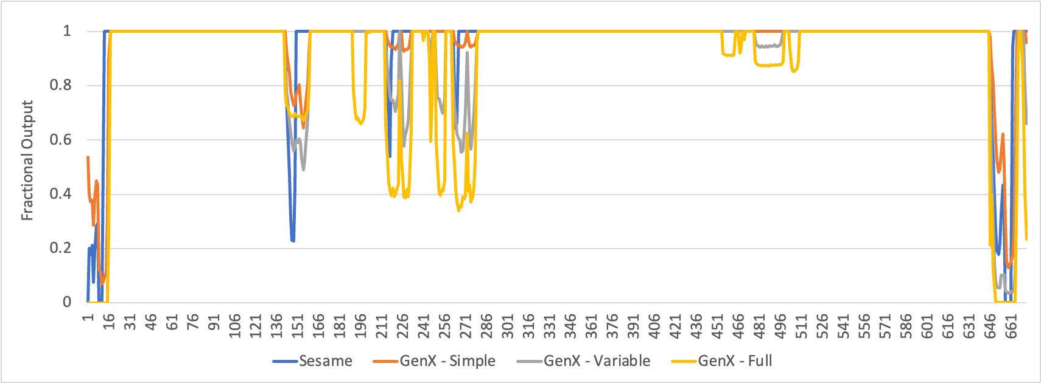
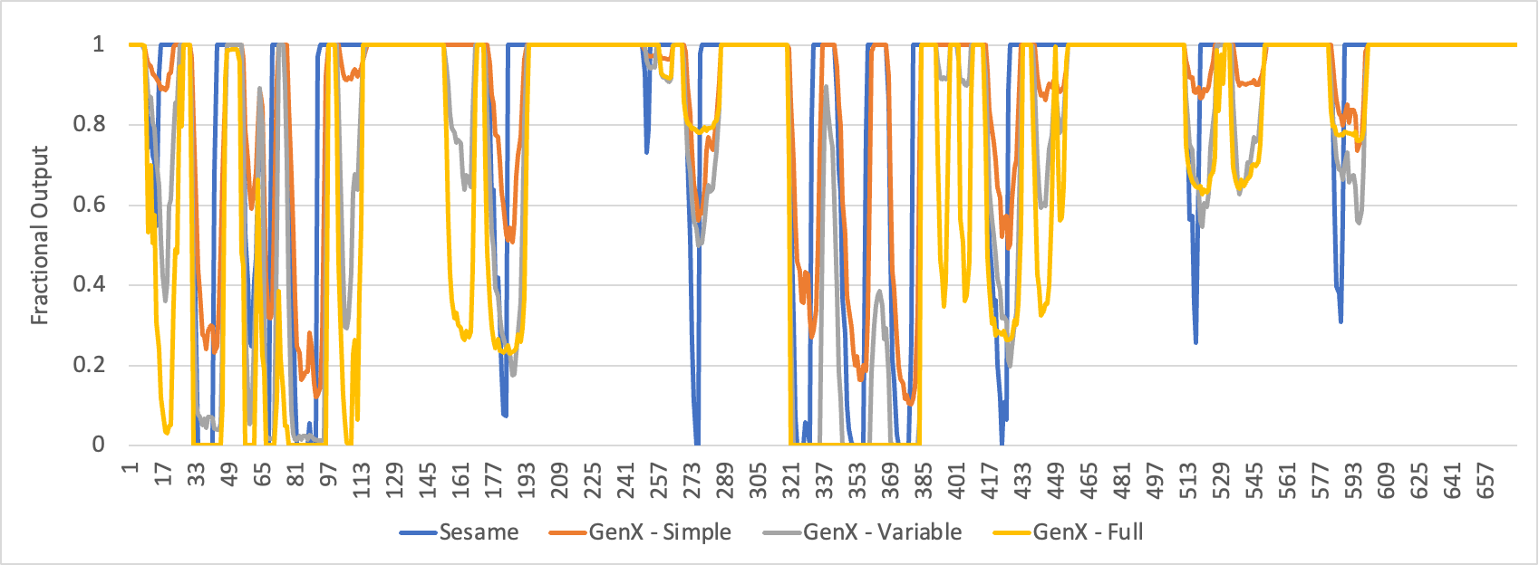
Fusion Power Plant Dispatch by each model, Winter
Fusion Power Plant Dispatch by each model, Summer

